Slide 1
Object-Oriented Programming Concepts

Slide 2
Outline
Outline of the presentation?
Object-Oriented Programming
Class and Objects
Encapsulation
Inheritance
Polymorphism
OOP Usages
Q&A

Slide 3
Object-Oriented Programming
What is OOP?
OOP is a concept of visualizing everything around us as objects and putting them into programming
Why it is important?
Reusability
Ease of programing
Real world modeling
Efficient

Slide 4


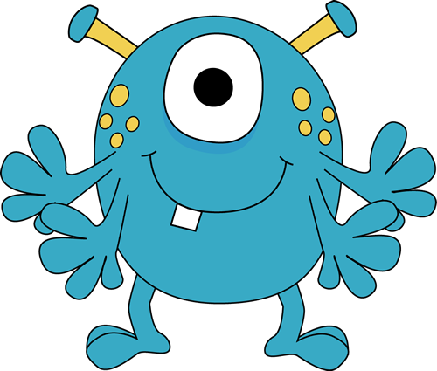
Class/Object
angrymonster= Monster(“purple", 2))
class Monster : def__init__(self,color, eye):
self.color = color
self.eye= eye
JollyMonster= Monster(“blue", 1)

Slide 5
Encapsulation:
What?
Encapsulation is the concept of capsulation data of class.
Why?
Its protect the fields of class from other class .

Slide 6

Encapsulation:
-Eye: 2 #Hand: 2
#Leg: 2 +Health: 2
Class AngryMonster(Monster)
Class captainAmerica (Hero)

Slide 7
Inheritance
👪
What?
Inheritance is a mechanism in which one class acquires the property of another class.
Why?
With inheritance, we can reuse the fields and methods of the existing class

Slide 8
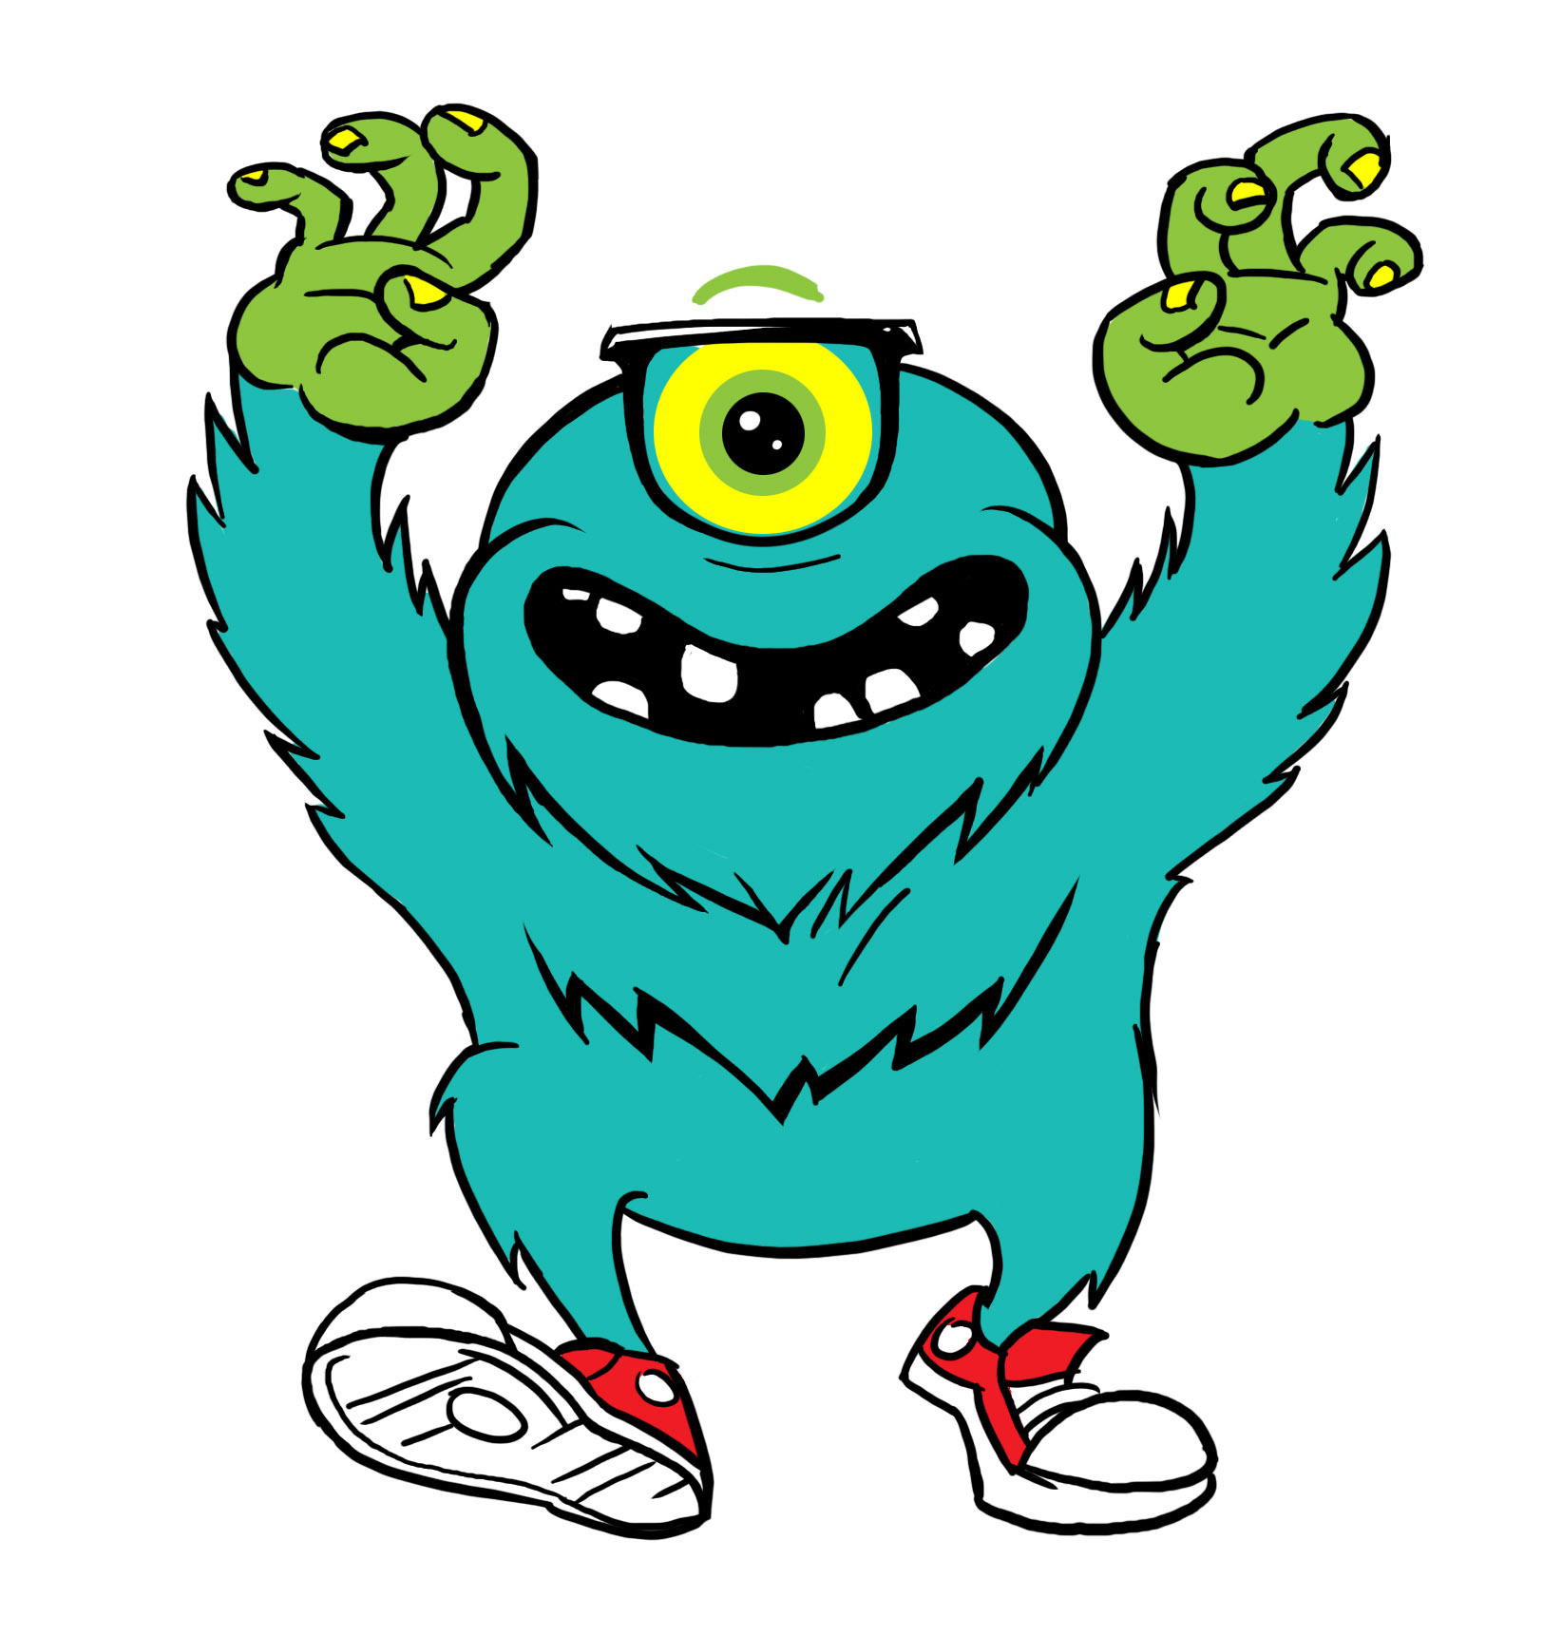
Inheritance Example
👪
Eye: 2 Hand: 0
Leg: 2
Class Monster()
Eye: 2 Hand: 2
Leg: 2 Scar: 2
Eye: 1 Hand: 4
Leg: 2
Eye: 1 Hand: 2
Leg: 2 Glasses: True Shoe: 2
Class AngryMonster(Monster)
Class JollyMonster(Monster)
Class NerdMonster(Monster)

Slide 9
Polymorphism
What?
Allow an entity such as a function to have more than one form.
Why?
Because different classes can be used with the same interface.

Slide 10
Polymorphism Example
Class BabyMonster(Monster)
Roar(Costume, Scream): Costume: Costume Scream: Little
Class Monster()
Eye: 2 Hand: 0
Leg: 2
Roar()
Class GodzilaMonster(Monster)
Roar(Scream): Godzilla_Scream: Scream Return Godzilla_Scream

Slide 11
OOP Usages
OOP Usages.
Corporate Software.
Game Development.
Automation Cars
Facebook, Google etc.
And many more.

Slide 12
Use of OOPs?
Corporate Software.
Game Development.
Automation Cars
Facebook, Google etc.
And many more.

Slide 13
Q&A
Any questions on the presentation?

Slide 14
Reference
Object-oriented programming (OOP) - /searchmicroservices.techtarget.com [05.06.18]
Object-oriented programming - /wikipedia.org [07.06.18]
Understanding classes and objects - /ncl.ucar.edu [06.06.18]
OOP Concept for Beginners: What is Encapsulation - /stackify.com [08.06.18]
Inheritance (object-oriented programming) - /wikipedia.org [01.06.18]
Polymorphism (computer science) - /wikipedia.org [03.06.18]

Slide 15
Thank you

